Slide 1
Msc final project: Presentazione 1
20/02/2026

Slide 2
Workflow of the Thesis
Obsidian vault to keep track of every notion/photo/citation/paper added to the project
Still waiting for a Laptop and a VPN
Succesfully plotted data from HYDRA3 atmospheric timeseries
Succesfully plotted data from Tidegauges timeseries

Slide 3
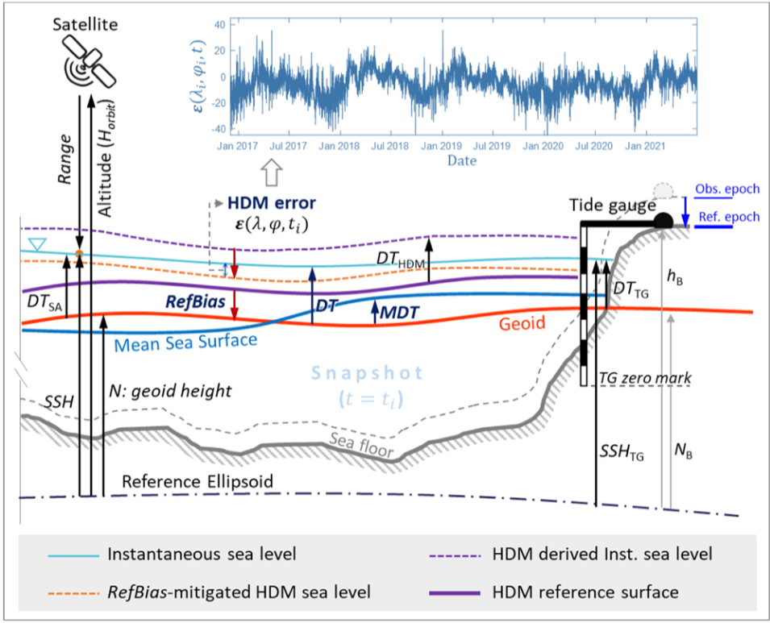


Introduction to the problem
DINAMIC TOPOGRAPHY (from TGs)
E is the discrepancy between the modelled DT and the ground- truth sea level
HDM error (dinamic)
Vertical reference error (static)
REFBIAS: that is the difference between the geopotential surface of the HDM and a particular geoid model used for the observations

Slide 4
DATA
Meteorological data (NetCDF)
2013-2024
Spatial resolution: 2.5km resolution (10m wind, SLP)
Temporal resolution: Hourly
tidal gauge observation data (CSV)
- Temporal resolution: 10 minutes
- 2013-01-01 → 2023-01-01
Modelled sea level data in western Baltic Sea (NetCDF)
- Run every 4 hours
- 2013-2026
- Spatial resolution: 0.9 km x 0.9km
SA

Slide 5
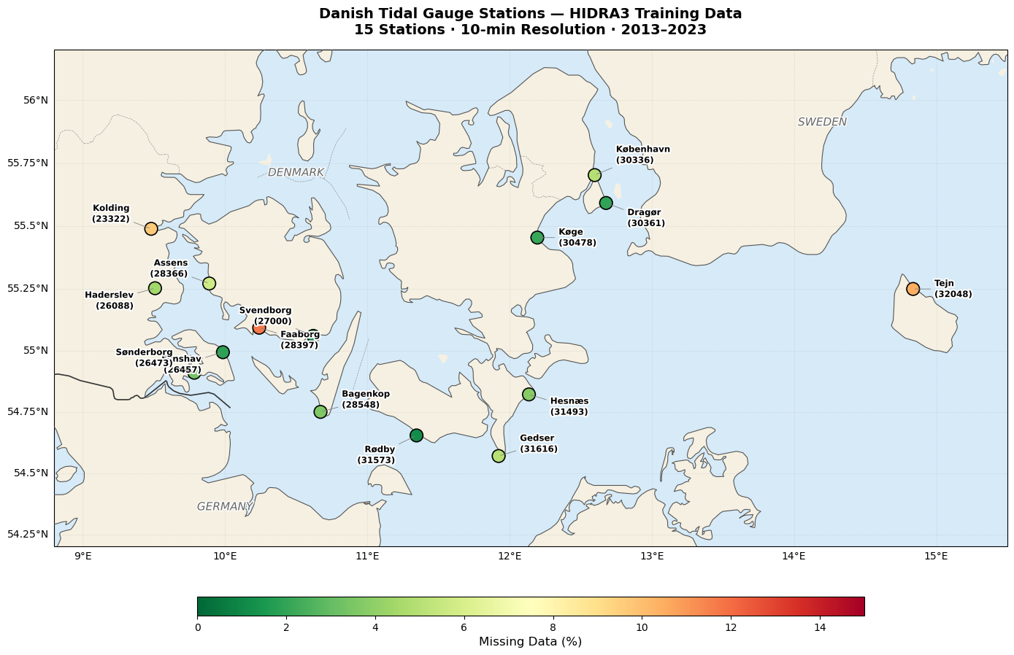
DK TIDAL GAUGES STATIONS
Hoping to have more of them

Slide 6
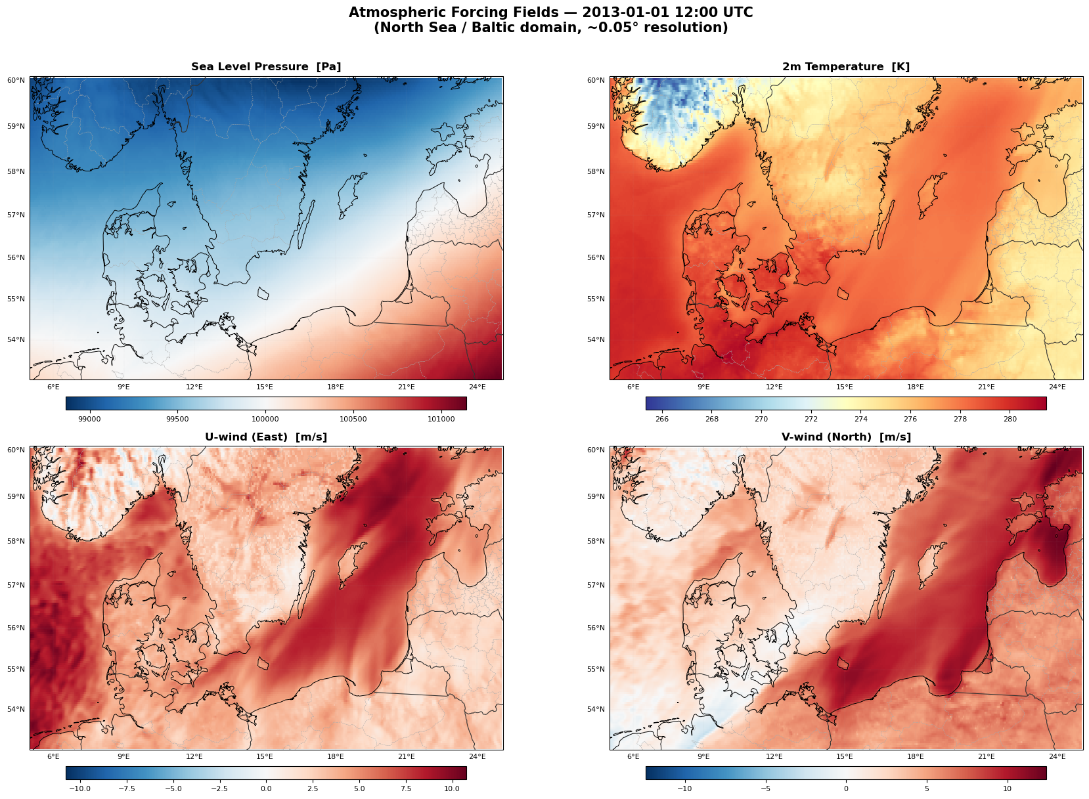
HYDRA3 atmospheric forcing records
Temperature at 2m
Northward wind
Eastward wind
SLP

Slide 7
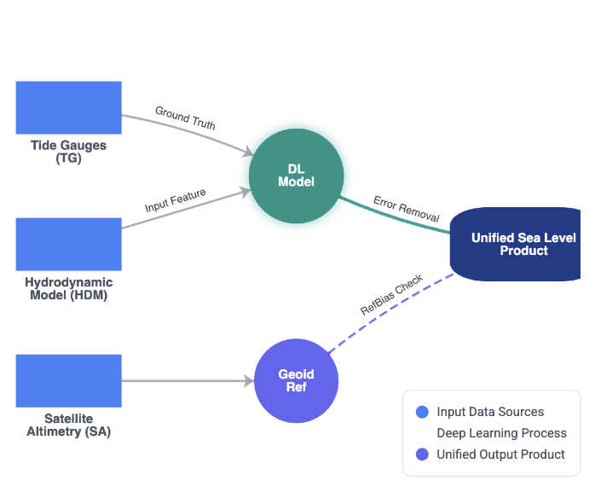
DATA SYNERGY

Slide 8
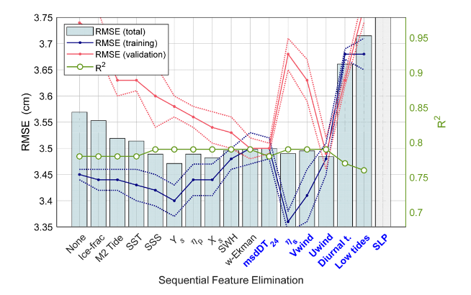
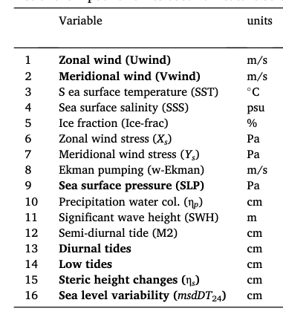
Input features (from paper)

Slide 9

Selected Hyperparameters (from paper)
(Resonant oscillation: these effects heavily rely on the geometry of the basins)

Slide 10
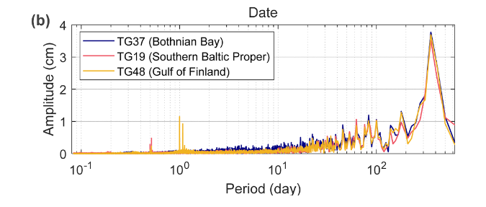
Next step
Frequency contents of the corresponding signals.

